Slide 1
Computer System Architecture
First week’s Report
名前：劉立坤
学籍番号：2IE19337P

Slide 2
Benchmark programs
FMM
Ocean
FFT
Reason: These programs are relatively parallel and can be solved with greater efficient with multi-core processor

Slide 3

Parameters to consider
Number of Cores ($2^{n}$)
L1 cache size and associativity
L2 cache size and associativity
Hardware Cost

Slide 4
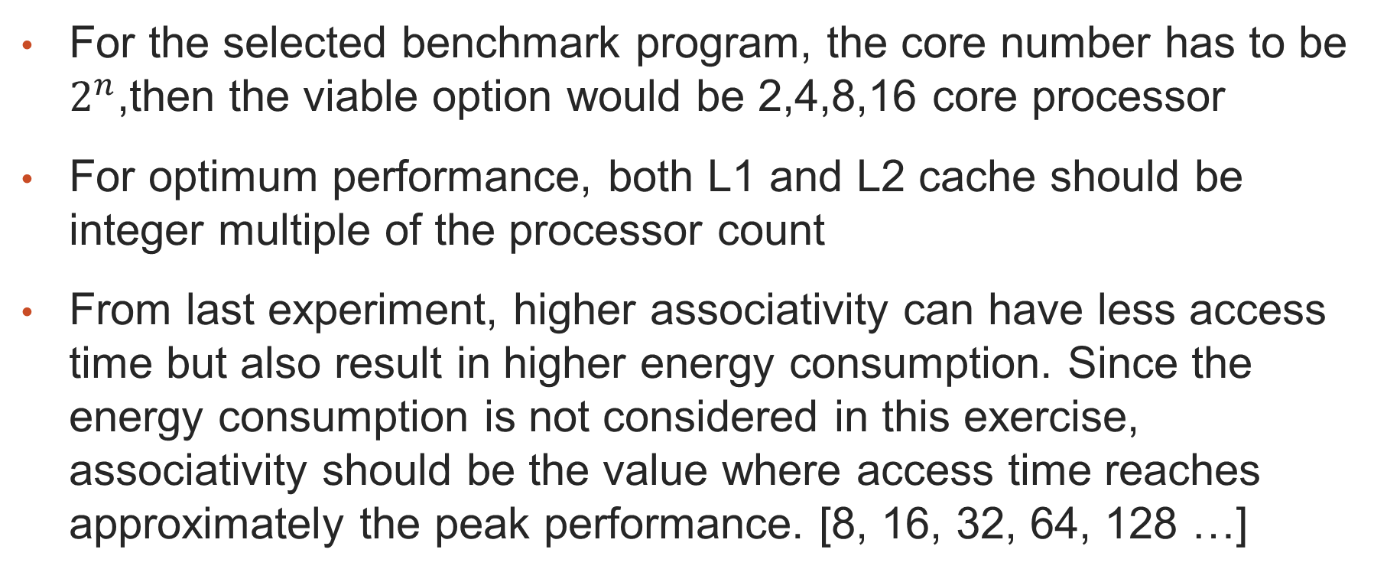
Conditions
For the selected benchmark program, the core number has to be $2^{n}$,then the viable option would be 2,4,8,16 core processor
For optimum performance, both L1 and L2 cache should be integer multiple of the processor count
From last experiment, higher associativity can have less access time but also result in higher energy consumption. Since the energy consumption is not considered in this exercise, associativity should be the value where access time reaches approximately the peak performance. [8, 16, 32, 64, 128 …]

Slide 5
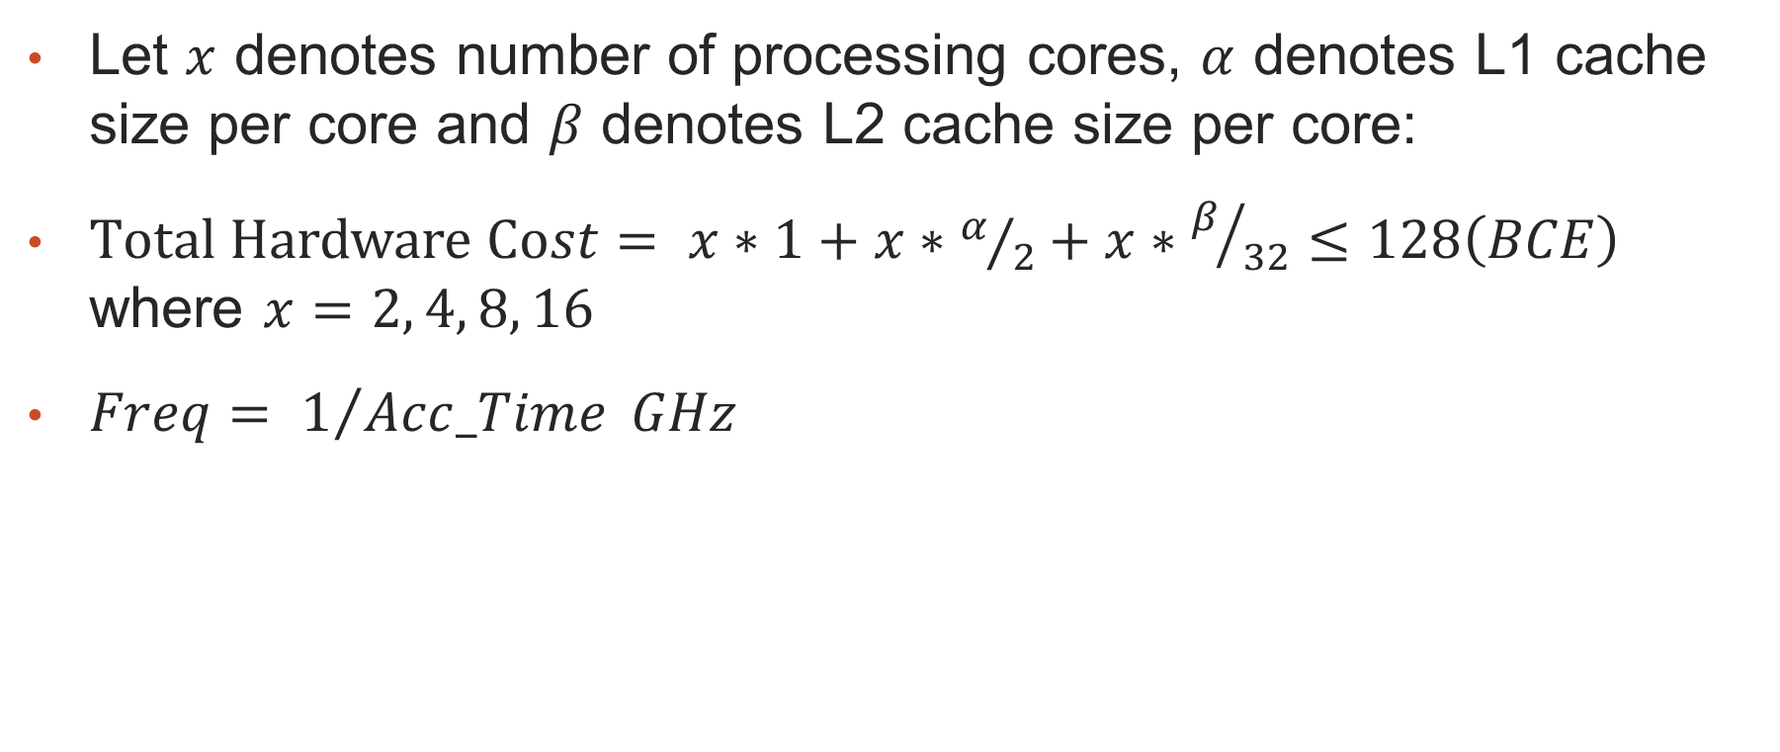
Constrains
Let $x$ denotes number of processing cores, $α$ denotes L1 cache size per core and $β$ denotes L2 cache size per core:
$Total Hardware Cost= x∗1+x∗α/2+x∗β/{32}≤128\left(BCE\right)$ where $x=2, 4, 8, 16$
$Freq= 1/{Acc_Time} GHz$

Slide 6
Proposed options
Cores | L1 Cache (kB/core) | L2 Cache (kB/core) | BCE
2 | 32 | 1024 | 98
2 | 64 | 512 | 98
4 | 16 | 512 | 100
4 | 32 | 256 | 100
8 | 16 | 128 | 104
16 | 8 | 64 | 112

Slide 7
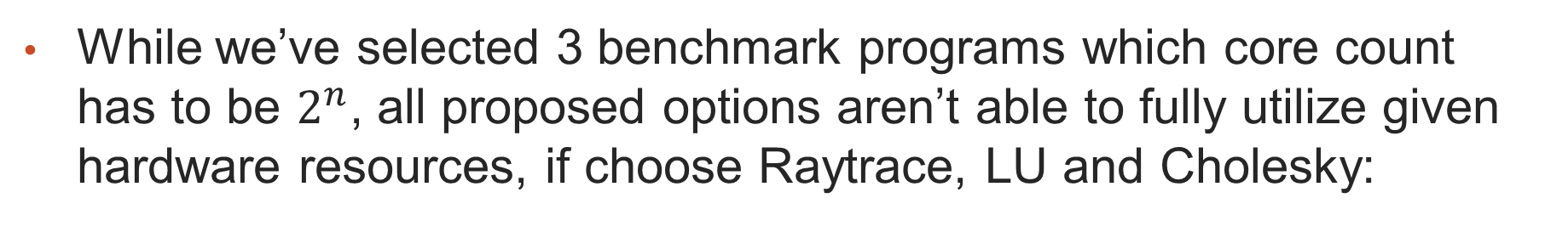
* Supplemental
While we’ve selected 3 benchmark programs which core count has to be $2^{n}$, all proposed options aren’t able to fully utilize given hardware resources, if choose Raytrace, LU and Cholesky:
Cores | L1 Cache (kB/core) | L2 Cache (kB/core) | BCE
6 | 32 | 128 | 126
The option above can almost fully utilize hardware resource, and is worth give a shot if time is sufficient.

